Slide 1
Enigma Cipher
By: Prashaant Mudgala
Mentor: Nolan Ashvin Miranda

Slide 2
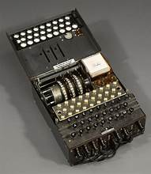
Enigma Cipher
Background:
The Enigma cipher was developed in the 20th century and highly used during WWII.
The Cipher was one of the most powerful at the time and the only way to decipher a text encrypted by the cipher was to obtain the key.

Slide 3
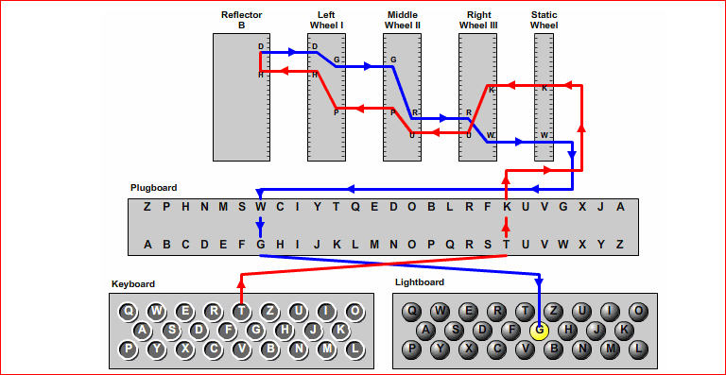
Overview of Enigma Machine parts:

Slide 4
The first component of the Enigma Machine is the keyboard.
It takes in user input to be ciphered.

Slide 5
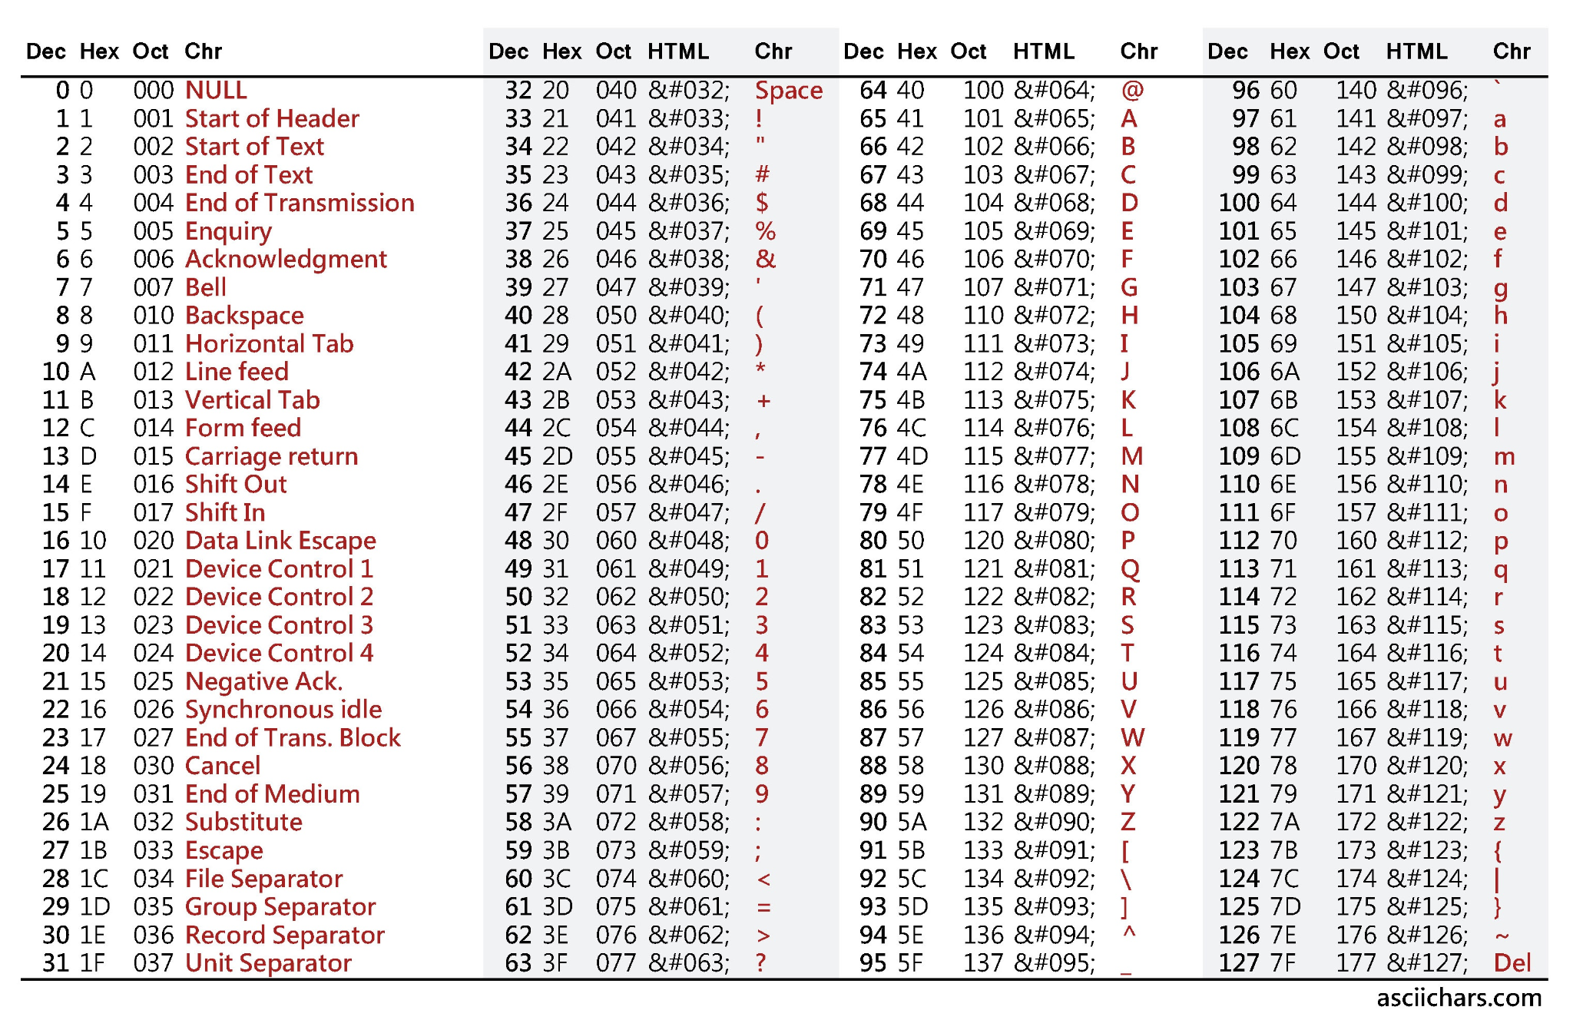
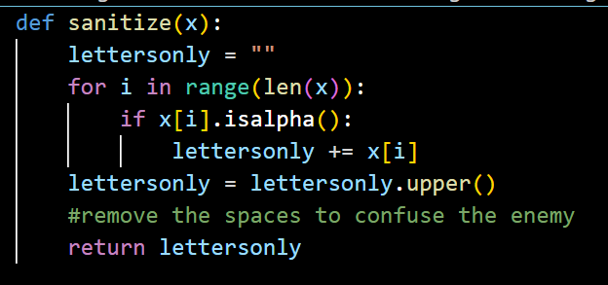
The “sanitize” function removes all spaces and capitalizes the entire message
No spaces strengthens the ciphered text
Capital letters simplify coding the routers with the use of the ASCII chart.

Slide 6
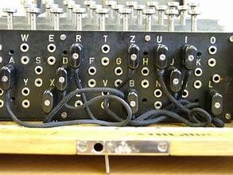
The second component of the machine is the plugboard.
The plugboard has to be used manually to swap letters with an inserted plug.
This is where the first cipher happens.

Slide 7
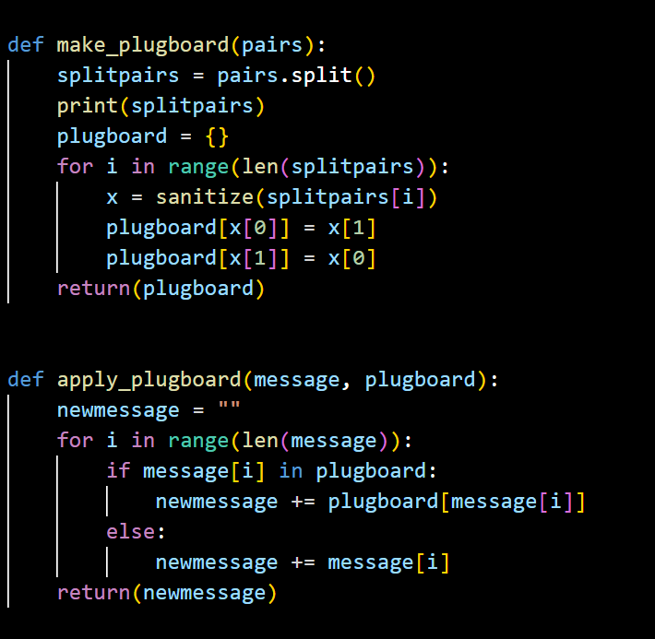
Creating 10 plugboard pairs was a conventional number when using the enigma machine, although 13 pairs are the maximum possibility.
I created a string variable to store all my pairs and used the “.split” method to break them apart in my function.
My pairs:
b & q
c & r
d & i
e & j
k & w
m & t
o & s
p & x
u & z
g & h

Slide 8
The static wheel contains all of the alphabet.
It receives the letters from the plugboard to be ciphered and sends them back out of the plugboard once ciphered.
It is the starting wheel.

Slide 9
If no plugs are inserted is the plugboard, the letters go directly into the rotors.

Slide 10
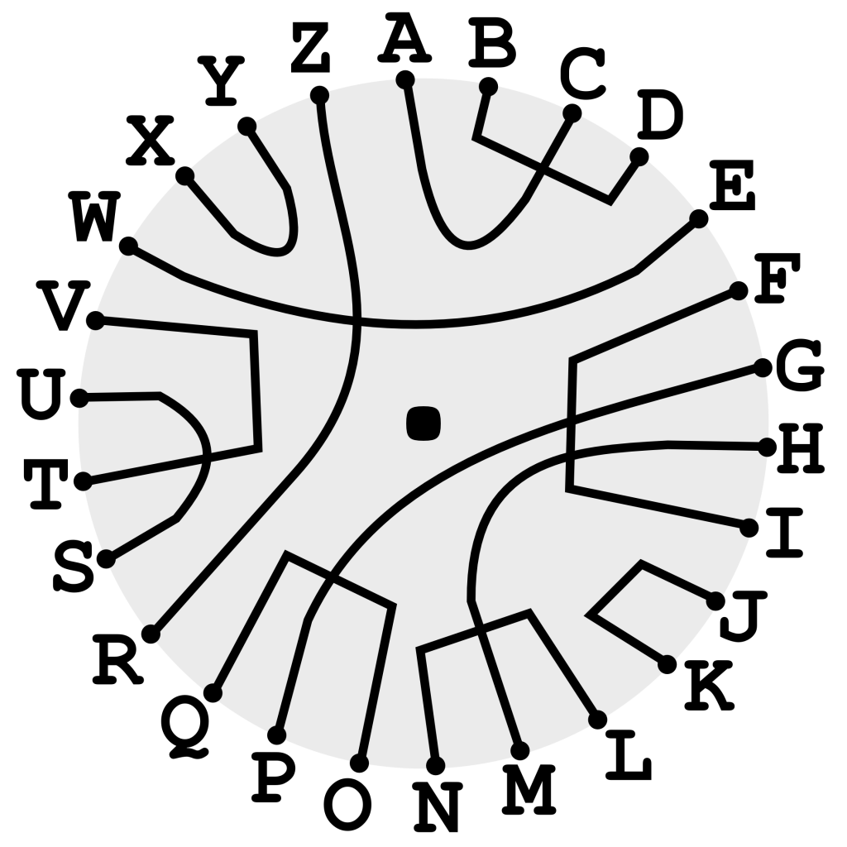
The reflector is where half of the alphabet is wired to the other half allowing for one swap of the letters before they re-enter the rotors.

Slide 11
The light board lights up the resulting letter after the cipher is completed.
This letter is the output of the cipher.

Slide 12
Why is the Enigma Cipher so unique?

Slide 13
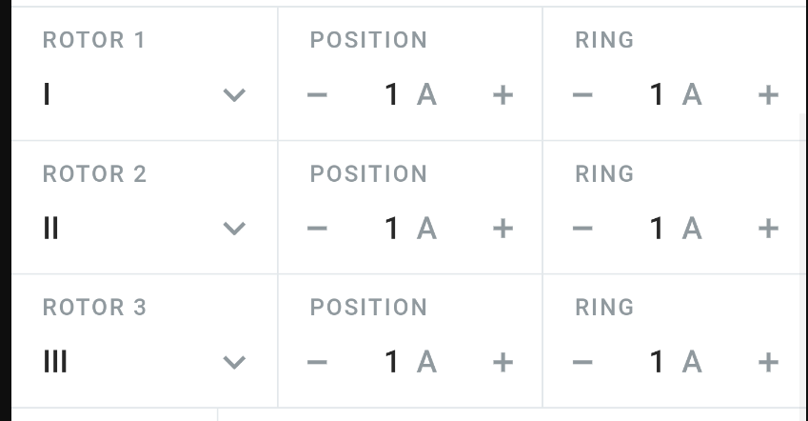
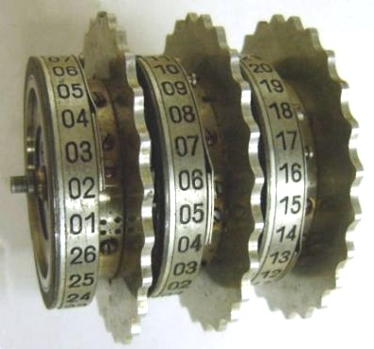
Rotors
The rotors are labeled 1-26:
1 corresponds to A
2 corresponds to B
…
26 corresponds to Z
Rotor 3:
Rotates every time a key is pressed on the keyboard.
Rotor 2:
Rotates after ~26 turns of Rotor 3.
Rotor 1:
Rotates after ~26 turns of Rotor 2.
* The two notches on rotor 1 & 2 are on letters “W” and “F”

Slide 14
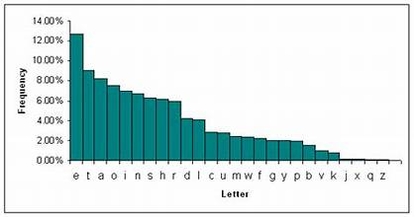
Why is the Enigma Cipher so unique?
Each letter is always paired up with a different corresponding letter.
The spinning rotors make it to that the letters are swapped randomly every time so there are no weaknesses in the cipher.
For example: there is never a most repeated letter to try and decipher the code with.

Slide 15
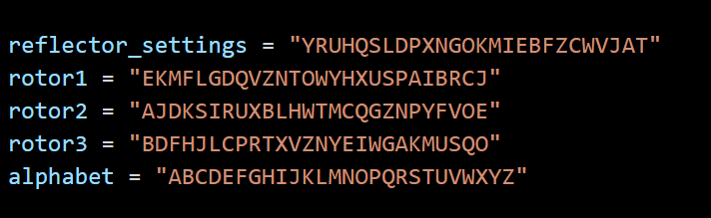
Model: Enigma I
Reflector: UKW B
The settings used for this model and reflector were assigned to the following variables in the code:

Slide 16
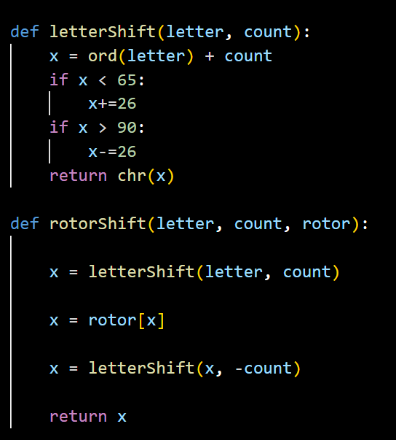
ASCII values for the capitalized alphabet allowed me to use Python’s “ord()” and “chr()” built in functions for conversions and shifts.

Slide 17
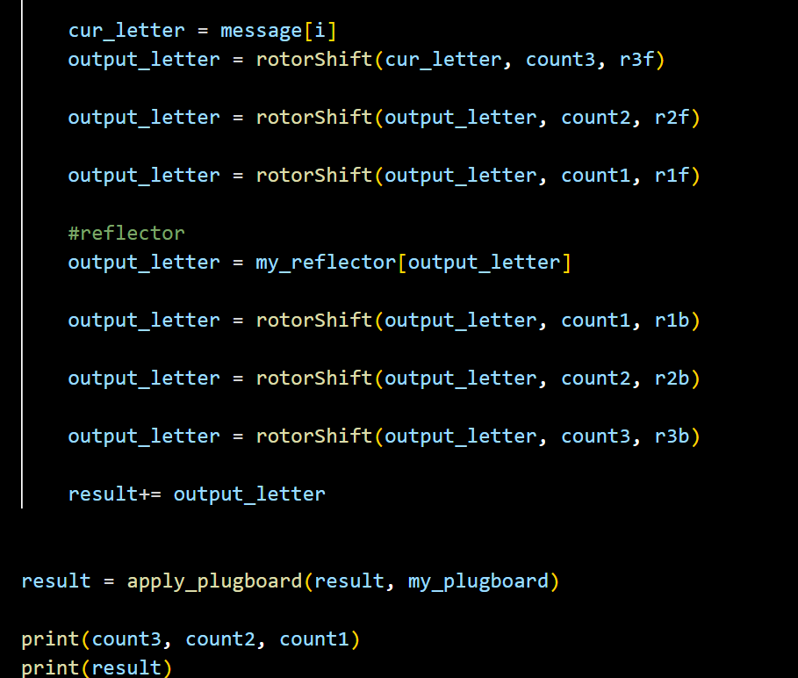
The last step in the code was to put the functions into action.
The user input goes through the rotors from rotor 3 → rotor 1, followed by an encryption by the reflector and then back from rotor 1 → rotor 3.
The result goes through the plugboard once again.
Finally the output is printed.

